Slide 1

GROUP 4

Slide 2

Group 4:
Oluwatofunmi Alabi
Noelle Cespedes
Sai Kiran Gontyala
Yoshitha Gattu
Uchechukwu Okafor

Slide 3
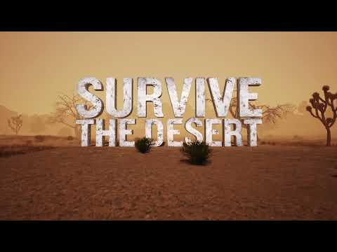

Slide 4
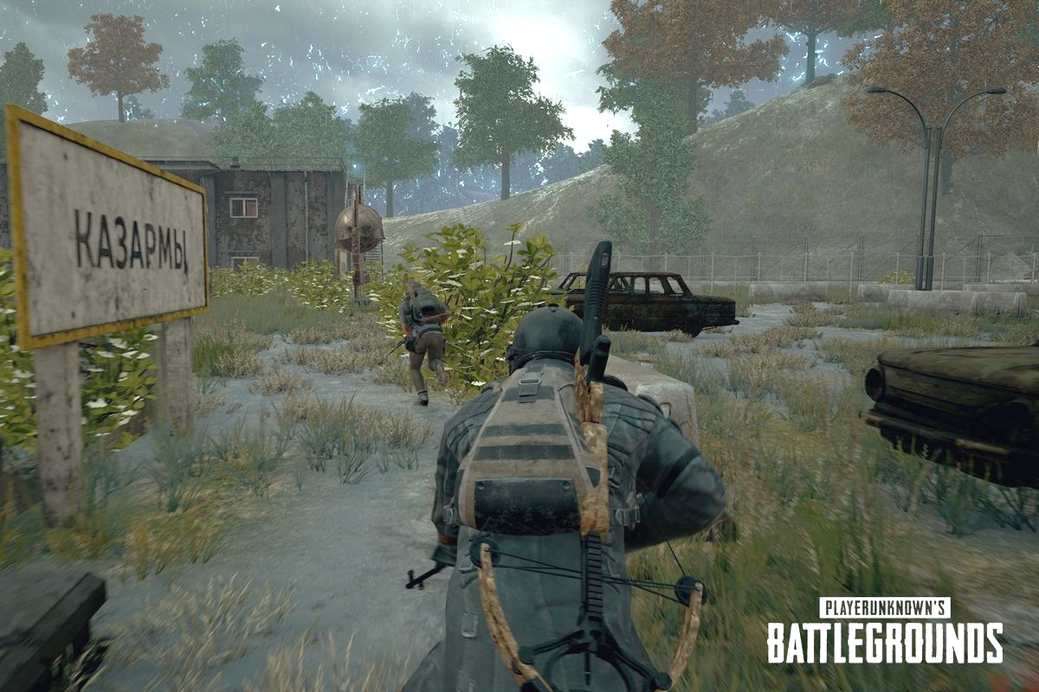
About PUBG
PlayerUnknown's Battlegrounds (PUBG) is a multiplayer online battle royale game
Developed and published by PUBG Corporation, a subsidiary of publisher Bluehole.
The game starts with parachuting onto the game island.
On landing the mission is to gather everything you can to win, from clothes to medical supplies to weapons, with a wide range of weapons and modifications for those weapons.
The full area is initially playable.
Play areas decreases in size as time progresses.
Players are forced closer together with ever decreasing circles, those left out will start to take damage and eventually die.
The game reaches its climax when the last players are condensed down into a small space.
One player or team emerges as the victor.

Slide 5
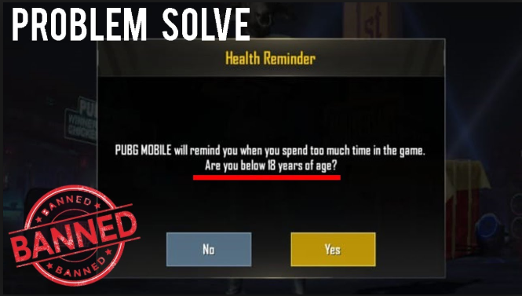
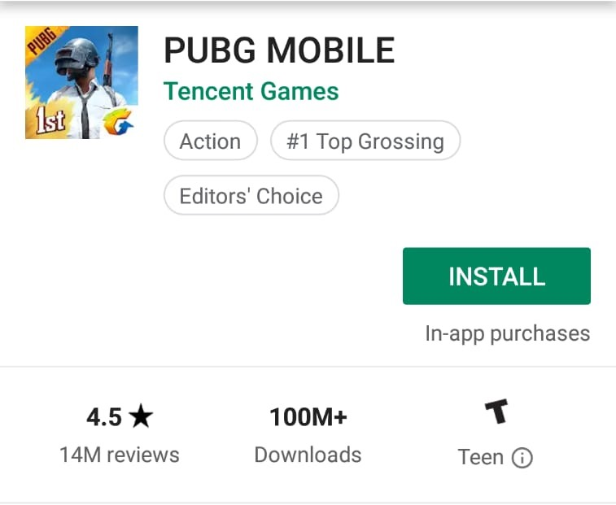
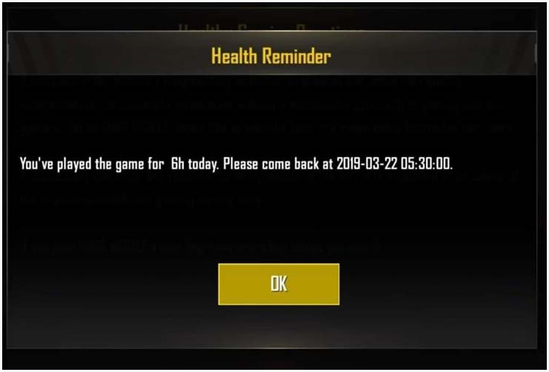

Slide 6

INTRODUCTION
Dataset Size: 8GB (unzipped & cleaned)
Queries to filter and categorize top important
information.
https://www.kaggle.com/skihikingkevin/
pubg-match-deaths

Slide 7
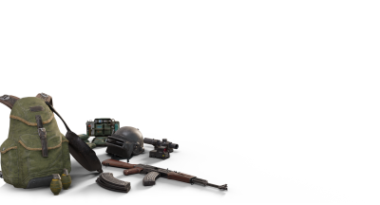
PROJECT OBJECTIVE
Learn how to use HiveQL, Power BI and Excel.
Filter out and visualize statistical data.
Compare visualizations on various aspects.

Slide 8

PLATFORM SPECIFICATIONS
Dataset size: 8GB (unzipped & cleaned)
Cluster version: Oracle Cloud 4.2
No of nodes: 6
Memory size: 180 GB
storage : 682 GB
CPU Speed: 2.2GHz

Slide 9





DATA PROCESSING
HADOOP

Slide 10
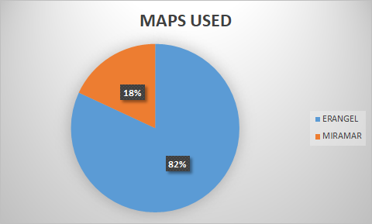
MAP LOCATIONS PLAYERS ARE INTERESTED IN
The game has 2 locations.
82% of the players play in ERANGEL.
18% play in players in MIRAMAR.

Slide 11
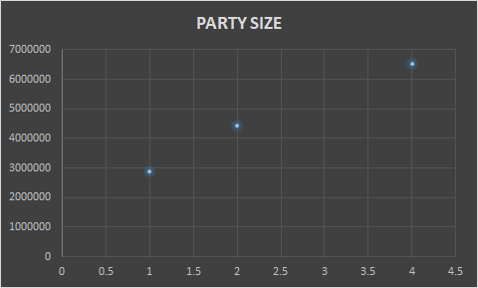
PARTY SIZE PLAYERS ARE INTERESTED IN
There are 3 party sizes in the game: 4, 2 & 1.
Most players play in a SQUAD, composed of 4 players.
Few play as a single player.

Slide 12
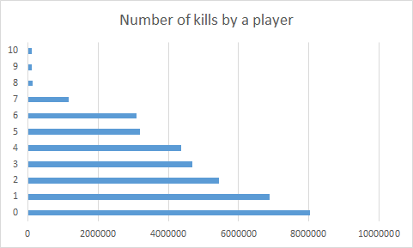
NUMBER OF KILLS BY A PLAYER
8,043,195 players die without killing any enemies.
6,881,553 players have killed only 1 player.

Slide 13
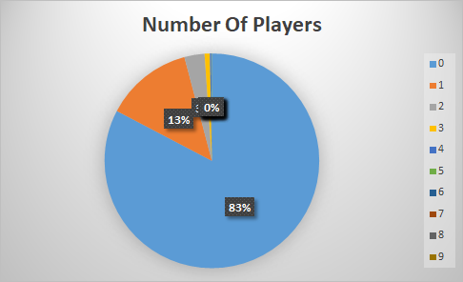
PLAYERS WHO SCORED ASSIST POINTS
In the past, if a teammate shot and finished off an enemy that you had “Downed,” they would get the credit for the kill and the victim gets nothing.
With this incoming update (no release window was given), if a player downs an enemy but a teammate finishes them off, the kill-stealer will be credited with an assist, with the kill credit going to the player who originally downed them.

Slide 14
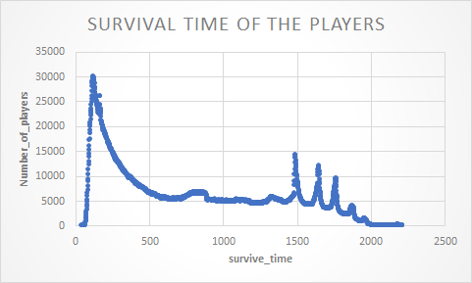
SURVIVAL TIME OF THE PLAYERS
Over 30,000 players survive upto 125 seconds.
Others survive longer in the game.

Slide 15
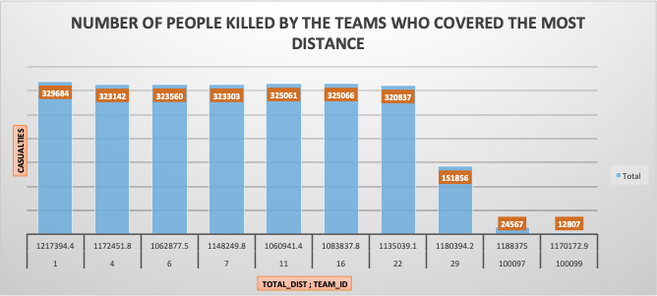
NUMBER OF PEOPLE KILLED BY TEAM WITH HIGHEST COVERED DISTANCE
Team with the highest distance covered also has the highest number of casualties.

Slide 16
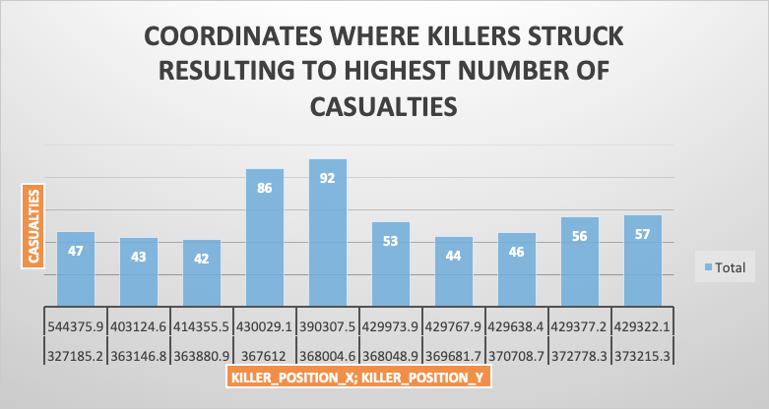
COORDINATES WITH HIGHEST NUMBER OF CASUALTIES
Exact coordinates where killers struck from which resulted to the highest number of casualties.

Slide 17
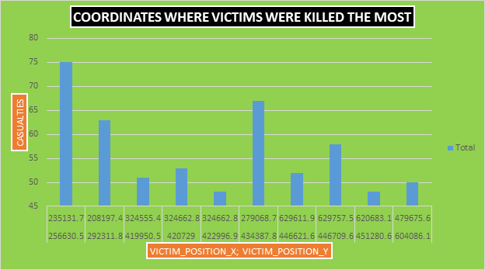
COORDINATES WITH HIGHEST NUMBER OF CASUALTIES
Exact coordinates where victims were struck and killed the most.

Slide 18
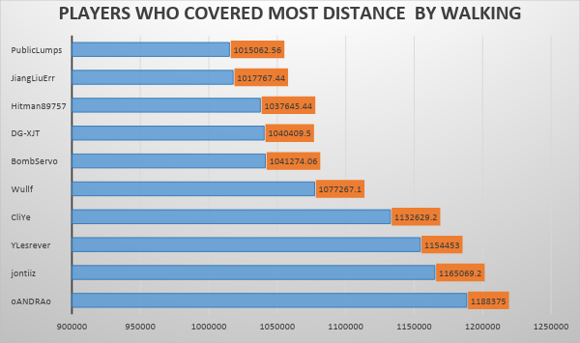
DISTANCE COVERED ON FOOT
The highest distance covered on foot is about 1,188,375 miles by a player called ‘Oandrao’.

Slide 19
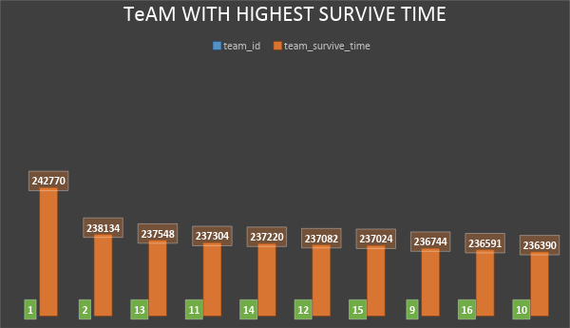
HIGHEST SURVIVAL TIME
The highest time taken was 242,770 hours by TEAM_ID = ‘1’ in order to survive on the battle ground.

Slide 20
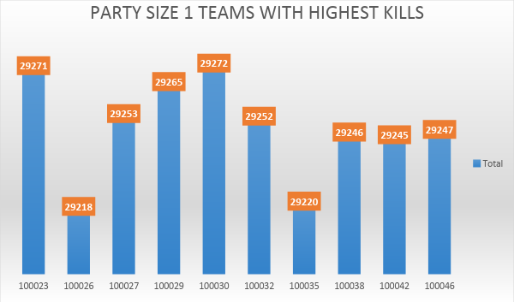
HIGHEST KILLS-SINGLE PLAYER
Player 100,030 has the highest number of kills which equal 29,272.
PARTY SIZE 1 - HIGHEST KILLS

Slide 21
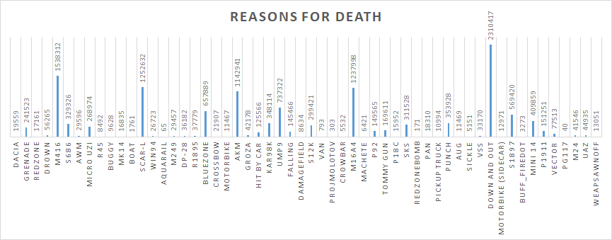
REASONS FOR DEATH OF A PLAYER
Most of the players are “Down and Out” followed by a kill with the “M416” weapon.

Slide 22
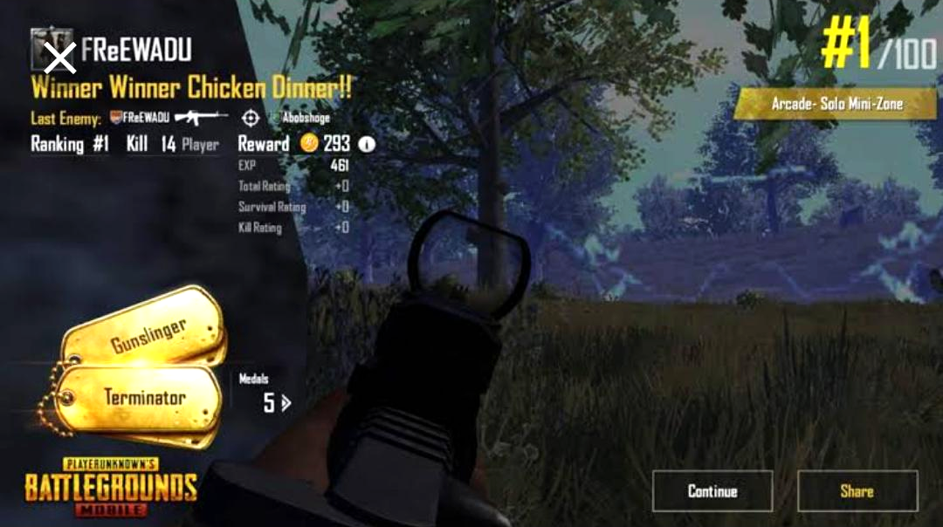

Slide 23
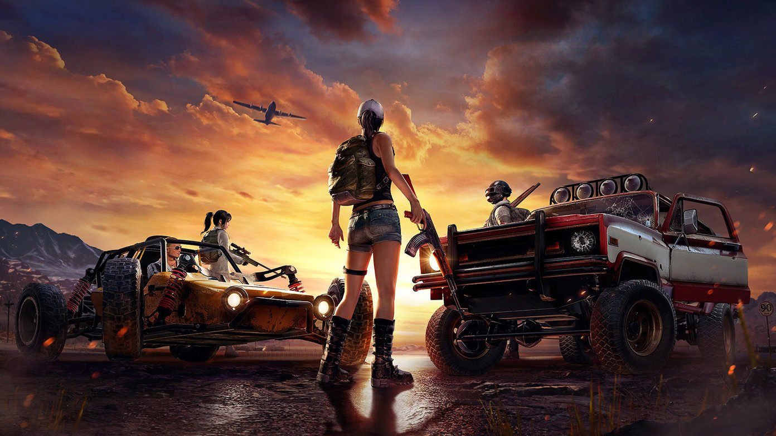
SUMMARY
Successfully used many tools learned in the class such as HiveQL, Oracle cloud to analyse.
Visualized data using the tool: Power BI and Excel.
Learned various terminologies of the data set and analysed various characteristics of the game.
Gained insight as per the user/player tactics and strategy.

Slide 24
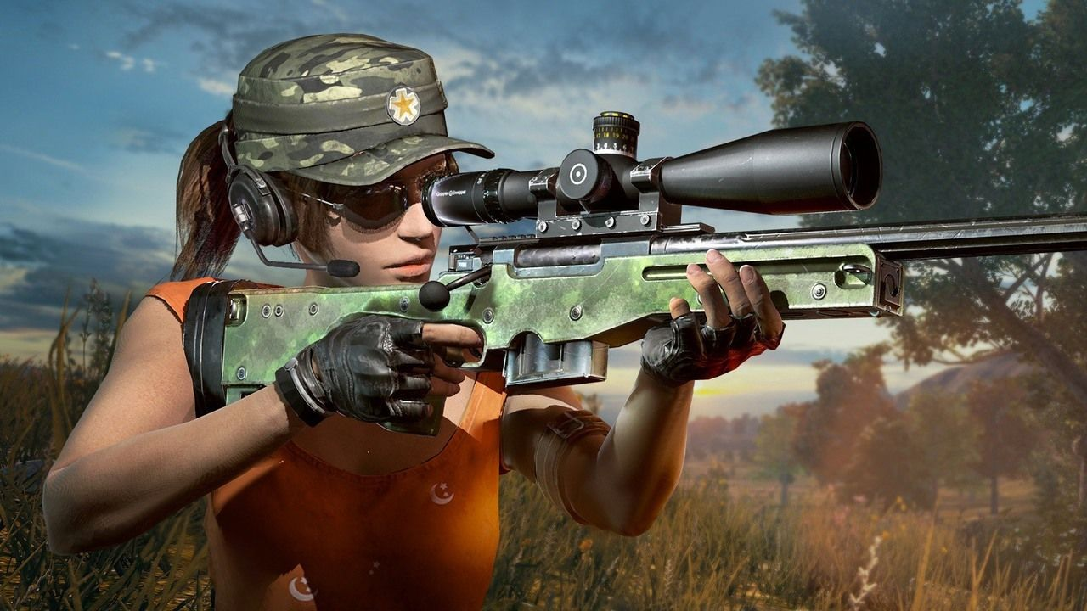
REFERENCES
https://www.kaggle.com/skihikingkevin/pubg-match-deaths
https://www.pocket-lint.com/games/news/144028-what-is-pubg-mobile-and-why-is-everyone-talking-about-playerunknown-s-battlegrounds

Slide 25
REFERENCES
https://www.pubg.com/
https://store.steampowered.com/app/578080/PLAYERUNKNOWNS_BATTLEGROUNDS/
https://github.com/sgontya/hiveanalysisonpubgdeathrate

Slide 26

GAME OVER

